Slide 1
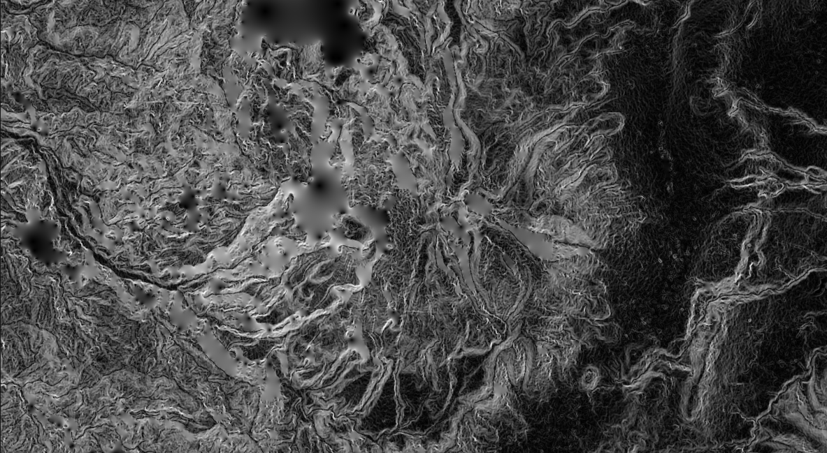

GIS for Geoscientists Lecture 3: Intermediate GIS
Presented by Nicholas Barber, 4th Year PhD Student at the University of Cambridge, U.K.
ndb38@cam.ac.uk | www.volcannick.com | https://github.com/ndb38 | Twitter @volcannick

Slide 2
Course Outline
Wed. Nov. 3rd: Session 1 – Principles for using GIS in the Geosciences
Course Objectives
Principles of GIS
Tour of the Interface
Wed. Nov. 10th: Session 2 – Beginner GIS Exercises
Guagua Pichincha Hazard Assessment (Exercise #1)
Projections + Data Types
Managing Layers, Manipulating Data, Designing Your Map
Wed. Nov 17th: Session 3 – Intermediate GIS Exercises
Wrapping up Exercise #1
Getting more out of GIS
Geoprocessing, Spatial Analysis, Data Management, Advanced formatting, Geostatistics
Wed. Nov. 24th: Advanced GIS Exercises
Peak into Advanced GIS
Custom Actions , Model Builder, Python, Google Earth Engine, Databases

Slide 3
Lecture 2 Review

Slide 4
Finishing Up From Session 2: Corrections + Analysis
Finishing up analyses:
Summarize Population for each census block
Field Calculator
Creation of Hazard Zones
Dissolve
Statistics in a particular Hazard Zone
Statistics Viewer
Layout and Map Making - elements we want:
Main Map
Regional Inset Map
Legend
North Arrow
Scale bar
Grid
Labels for important features
Text box summarizing findings

Slide 5
GIS and Ethics
Critical spatial thinking & unpacking racism and colonialism in GIS

Slide 6
What do we mean by ethics?
Traditional view: involves a judgement of what is right and why, taking into account local and external agendas that frame an issue (Crampton 1995)
Professional ethics is defined by the Royal Institution of Chartered Surveyors (RICS, 2000) as “giving of one’s best to ensure that clients’ interests are properly cared for, but in doing so the wider public interest is also recognized and respected,” (Blakemore and Longhorn 2004).
GIS analyses conducted at the behest of a company or government may not align with concept of an individual's ethical behavior
Thinking about ethics in GIS involves making difficult decisions (Blakemore and Longhorn 2004):
Should I engage in such research if it has both good and potentially harmful outcomes?
What are the ethical dilemmas and potential liability in a government agency making statements about risk and future danger?

Slide 7
Maps are tools, but whose tools?
GIS is inherently tied to public and private power structures e.g., Navy’s development of GPS
Growth in the use of location tracking data and its underlying GIS applications is driven by desire to, “monitor, model, and control consumer behavior,” (Crampton 1995).
If conducting GIS in private sector, use of personal data has been argued to contribute to growth of a “surveillance society,” where individual privacy is not respected (Crampton 1995).

Slide 8
Mapmaking, colonialism, and racism
Development of geology and mapmaking in Britain inexorably tired to colonialism
“As blueprints of its structure, geological maps spread scientific order over the Earth’s surface.” – Stafford (1984)
Expansion of steam powered transportation primarily depended on geological surveys and geological maps (Stafford 1984)
Roderick Murchison (1792-1871) exemplified the union between geology, maps, and imperialism:
President of Geological Society of London between 1831-33 and 1841-43
Pitched government investment in geology in terms of strategic intelligence e.g., Turkish Reforms 1848 (Stafford 1984)
Referred to field work and mapping as “invasions,” or “conquests.”
“Science has never been value-neutral or completely objective; especially in the context of empire, it implies control, both as an instrument of administration and of knowledge.” – Stafford (1984)
How do these historical insights inform our use of GIS today?

Slide 9
Critical spatial thinking
How do we as geoscientists use maps?
What is the goal of making a map?
How do we access data?
Whose permission do we have to use that data?
What decisions do we make when we design a map that perpetuate inequity?
How do we ensure the results of our science have a positive impact on the people concerned?

Slide 10
Critical GIS applied to this course
Exercise #1: What do these analyses not consider? What inequities do they reproduce?
Data was collected from publicly available poster and their work has been cited
Our analysis produces an estimate of exposure to hazard
How were the original data and modeling gathered?
Analysis hinges on census blocks
How does our map actually help the communities affected?

Slide 11
Critical GIS applied to this course
Exercise #1: What do these analyses not consider? What inequities do they reproduce?
Data was collected from publicly available poster and their work has been cited – authors were not contacted or involved in course design
Our analysis produces an estimate of exposure to hazard – assumes homogeneity of population distribution in the area and in population characteristics i.e. what if a particular community is mostly elderly?
How do these communities feel about being classified as in different hazard zones? How does such a classification affect their ability to apply for loans?
How do these communities perceive hazard and risk at G.P.? What right does a white male scientists in the UK have to tell them who is or isn’t at risk?
How were the original data and modeling gathered?
Analysis hinges on census blocks - What inequities exist in Census techniques? Have some communities been undercounted or left out?
How does our map actually help the communities affected? How will the government use our map? What responsibility do we have for their decisions?

Slide 12
Going forward
Ask yourself – what is the impact of my GIS analysis? Am I behaving ethically?
These lessons are fundamental to GIS activities
Ethics underpins everything you do with spatial data!
Thanks to ben Edwards and Jazmin Scarlett for contributing to this section

Slide 13
Session 3: Intermediate GIS Exercises

Slide 14
New Material Today
Section 2: Advanced Formatting
Line Symbology
Draw Effects
Heatmaps
Raster Viz.
3D Viewer
Section 1: Advanced Analysis
Exercise 2: Fluid Geochemistry of G.P.
Importing CSVs
Spatial Joins
Interpolating Point Shapefiles
Exercise 3: Landslide Risk near Quito
Raster Statistics
Rasterizing a Shapefile
Raster Calculator
Zonal Statistics

Slide 15
Lecture 3, Section 1
Handling Difficult Data Imports, Spatial Joins, Interpolating between Points, Raster Calculator, Spatial Statistics

Slide 16
Outline of Today’s Activity
Exercise #2
We want to know the chemistry of the fluids measured at G.P. Are there hotspots of high SO4 activity?
Requires:
Importing known geochemical data.
Georeferencing 2 new maps
Importing a dataset with no lat/long information
Creating new features
Performing a spatial join
Interpolating to find hotpots
Exercise #3
Landslide Risk example
Importing precipitation data
Calculating Raster Slope
Rasterize rainfall
Use raster calculator

Slide 17
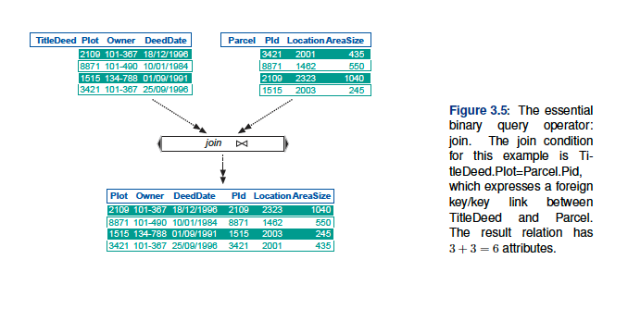
Spatial Joins
Image source: pg. 176 Huisman and de By (2009)

Slide 18
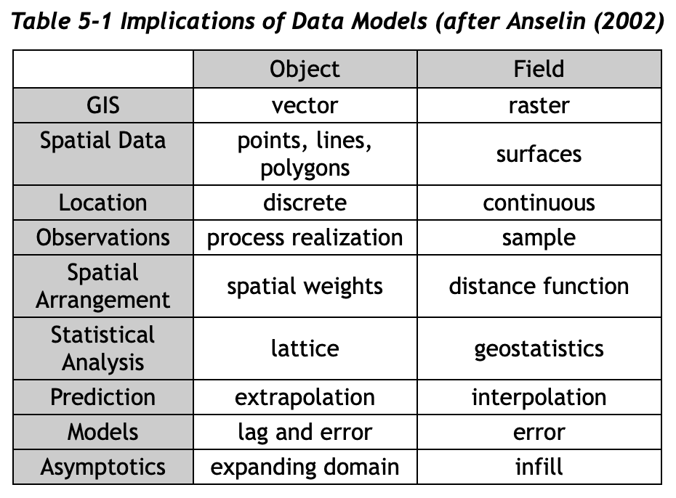
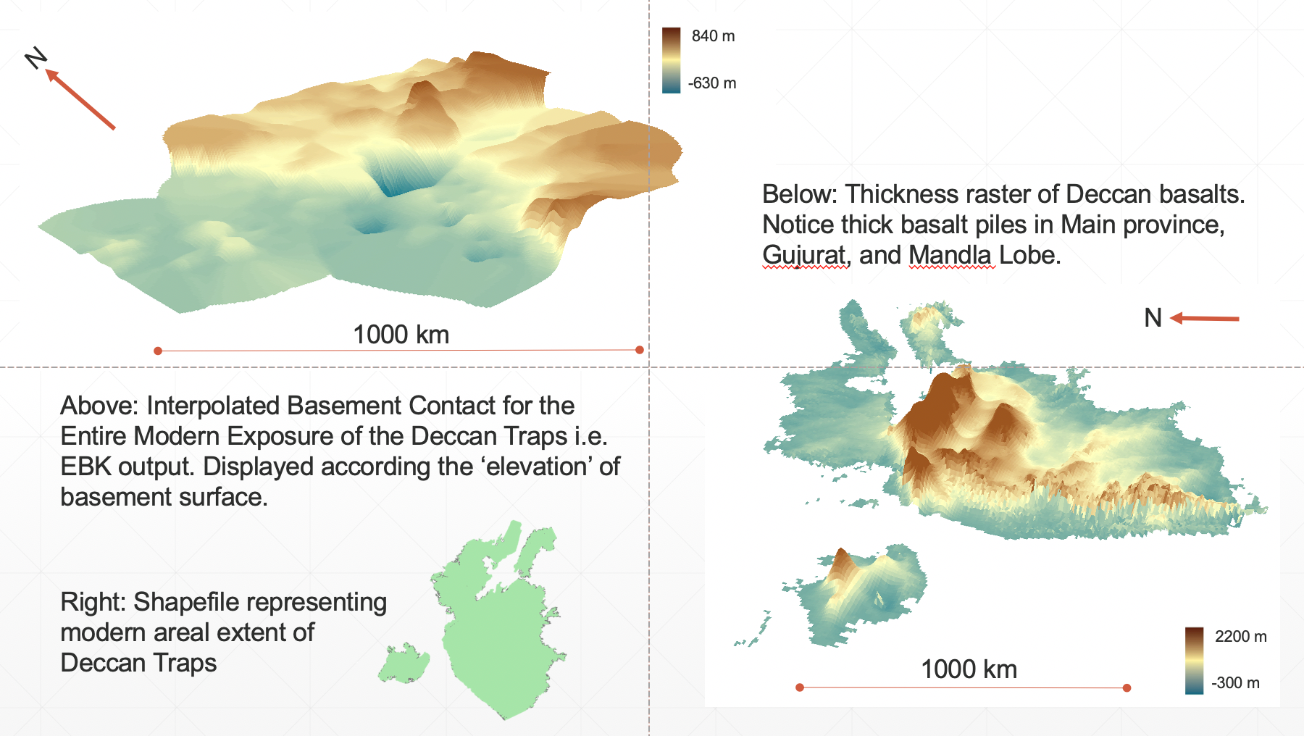
Geostatistics
Free AMAZING resource: https://www.spatialanalysisonline.com/HTML/index.html
One key feature of spatial statistics: because of spatial autocorrelation, data with a spatial dimension violate classical statistical assumption of independence
Independence – in probability theory, occurrence of event does not affect the probability of occurrence of another
Requires different approach to statistics and analysis
Special geostatistical operations: Inverse Distance Weighting (IDW), Kriging, Moran’s I coefficient
My Deccan work: Empirical Bayesian Kriging (EBK) >>>>

Slide 19
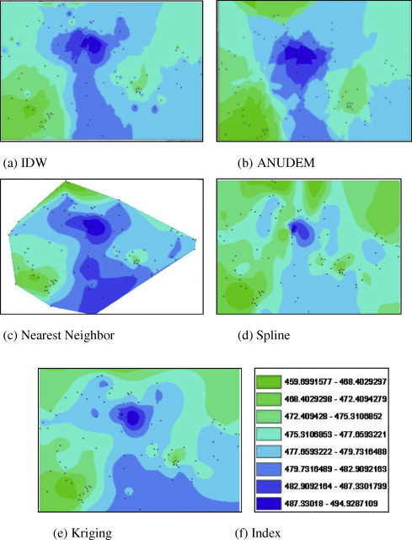
Interpolation
A popular family of geostatistical predictivemodels
Essentially, generates a surface connecting points.
Surface “height” refers to the difference in some desired value between the spatially heterogeneous points
Deterministic vs. Geostatistical methods offer different user choices, reflecting whether user thinks sample points reflect an underlying statistical sample
Image source: Arun (2013) A comparative analysis of different DEMinterpolation methods

Slide 20
Critical GIS
Do we have a responsibility to communicate these results to Ecuadorian geoscientists/local community?
If we identify a “hotspot” of activity, how can we ensure this message is passed along?
How will our interpolation model affect community perception of hazard, or impact livelihoods of community?

Slide 21
Section 2
Advanced Formatting

Slide 22
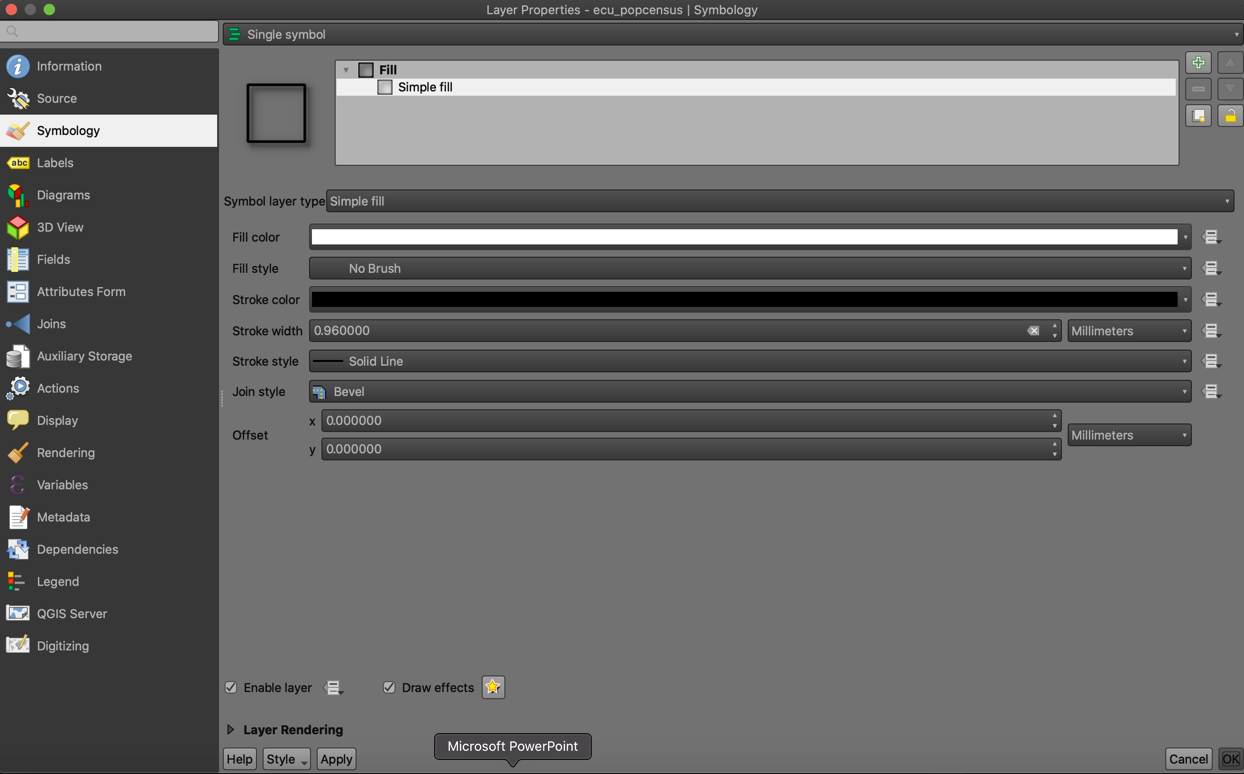
Symbology

Slide 23
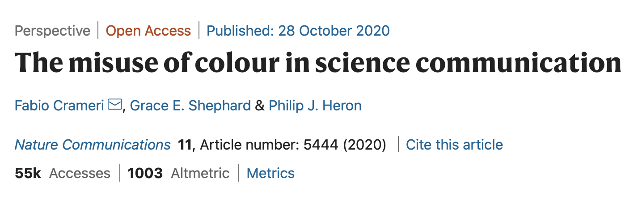
Symbology Advice
Design is an essential element of map making and GIS analysis
The appearance of your data affects how you and others perceive it (Crameri et al. 2020)
Experiment with symbology! When you submit your maps, I want to see different color scales, different polygon textures, different fonts.

Slide 24
Critical GIS
How does our choice of display/symbology/color affect the perception of our results by a diverse community of researchers?
Do our visualization techniques exclude key groups? Obscure underlying complexity?

